Slide 1


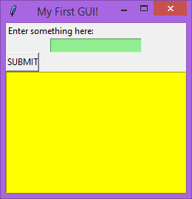
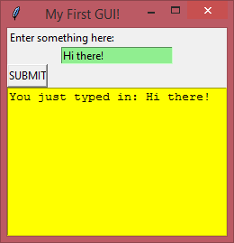
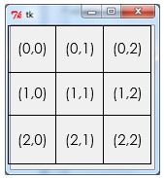
GUI Building with TKinter
Lesson 7 – making a calculator

Slide 2
Today’s lesson
Introduction
The most recent practical past papers included questions involving finishing or creating a simple calculator program in Tkinter.
We will start today by finishing a mostly completed calculator program, then look at building one from scratch.
Learning Objectives:
Practise & refresh Tkinter coding skills
Understand the code necessary to make a simple calculator program work in Tkinter

Slide 3


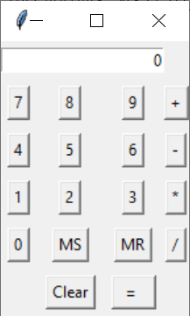
Activity 1
Download and open the file “calc.py” from the assignment on Google classroom.
This code will run, but it won’t work properly yet. Like the plumbers code you worked with previously, it is a mostly complete program with a number of key lines missing which need to be filled in.

Slide 4
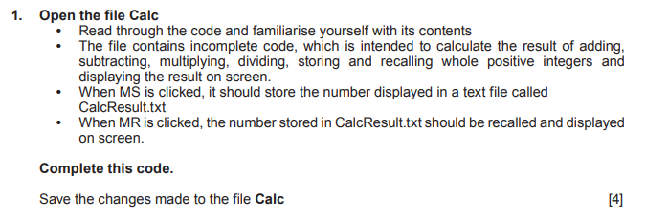
Tkinter – making a calculator
Past paper question from 2018
This was the first part of the programming section of the 2018 past paper.

Slide 5
Tkinter – making a calculator
Advanced concepts
You won’t need any new skills that you haven’t already learned for this – there are only 3 lines of code that need finishing, and these are all quite straightforward.
The main thing to note with this code is that it’s quite complicated! The main parts of it have been designed using some concepts that we haven’t been using – a class to handle the calculator functionality, and something called “lambda” functions for the button commands linking to the funtions controlling their behaviour, such as:
lambda: sum1.operation("minus")

Slide 6
Tkinter – making a calculator
Advanced concepts
Both of these concepts are somewhat more advanced than necessary – some of you may have been using them already, if so well done and continue to use them! They haven’t been part of the tutorials however, and you won’t need to learn how to use them for the exam.
When we make our own calculator program later on we won’t be using classes or lambda, so don’t worry about them!
Let’s focus on getting those 3 lines finished. Completing this code and testing the program will give you a good idea of what the form looks like a how it should work for when we come to build our own version.

Slide 7
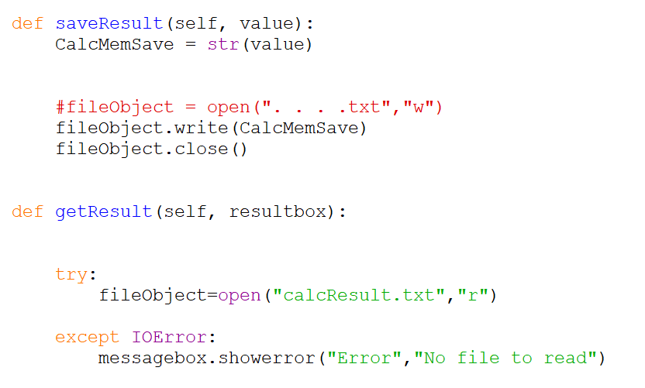
Tkinter – making a calculator
Completing the code
Let’s deal with the saving part first – find the section of code shown on the right.
This function is passed the current value in the calculators “screen” – the small displaybox at the top where the output is displayed.
All we need to do here is put the name of the file we want to save the value to into the space with the . . . .
The name of the file is given in the question on slide 4, and is also shown there in the getResult function.

Slide 8
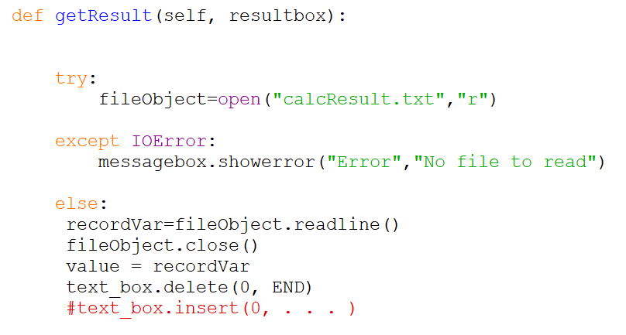
Tkinter – making a calculator
Completing the code
Next we’ll complete the last line of the getResult function.
A try – except is used to attempt opening the file in read mode. If the file does not exist it would cause an error, but this is caught by the except part.
If the file is there then the read operation is successful, and the code jumps to the “else” section at the bottom.
The value stored in the file is read in and stored in the “value” variable.
All we have to do now is put that variable name into the space at the end of the last line.

Slide 9
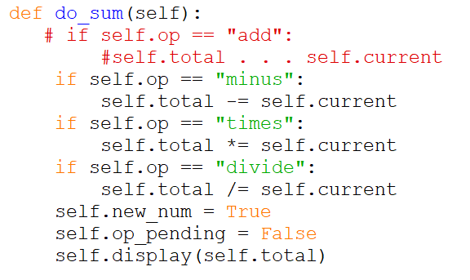
Tkinter – making a calculator
Completing the code
Next, we’ve got the do_sum function which performs the desired operation.
This may look a little daunting at first, but the only thing you actually need to do here for the marks is replace the . . . with the required operator.
Look at the other lines below it to see what is in that space, and use those as a clue for what you need to put in there.

Slide 10
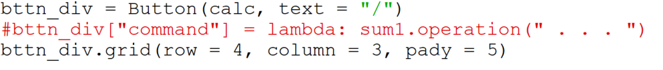
Tkinter – making a calculator
Completing the code
Finally, there’s the setup for the divide button to complete. The missing part here is simply the name of the operation which is given in the “do_sum” function we completed in the previous slide.

Slide 11
Activity 2
Using the guidance on the previous slides, add in the remaining lines of code to the calc.py file.
Test it thoroughly to check it is working according to the requirements of the question on slide 4, including all of the mathematical operations, and the saving and loading part using the MS and MR buttons.
The calculator does not perform particularly complex maths, and it will only do operations with two sets of numbers.
Save your code as “lesson 7 activity 2”

Slide 12
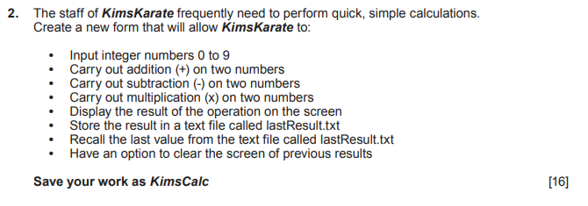
Tkinter – making a calculator
Making a calculator from scratch
This is the second part of the programming question from the 2019 past paper:
No code was given for this question – pupils were expected to create it from scratch which was a bit mean!
At least we don’t have to worry about division this time however.

Slide 13
Tkinter – making a calculator
Making a calculator from scratch
The functionality of the program is exactly the same as the one you completed for activity 2, but we’re going to be recreating it with a simpler structure, more similar to the code that you are used to from the tasks we were doing before.
You might be asked to recreate something like this in the exam, and we don’t want to overcomplicate things!
The first step is just to make the calculator interface with widgets, using a collection of buttons and an entry box to display our outputs.

Slide 14
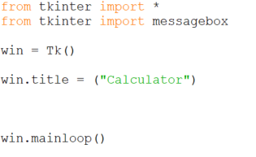
Tkinter – making a calculator
Making the interface
We’ll start off with a new empty Python file, and add in the basics that we’ve used before for setting up the Tkinter window.

Slide 15
Tkinter – making a calculator
Making the interface
Now let’s think about adding the widgets. Our interface doesn’t have to look exactly like the one from the previous activity, but it would be a good idea to try to replicate it reasonably closely.

Slide 16

Tkinter – making a calculator
Making the interface
We’ll start with the entryBox at the top.
Add in the following lines between the title and mainloop lines.
We’re using a new attribute here called columnspan. This allows the widget to be wider than normal, and not affect the other buttons we will putting in the grid below it.

Slide 17
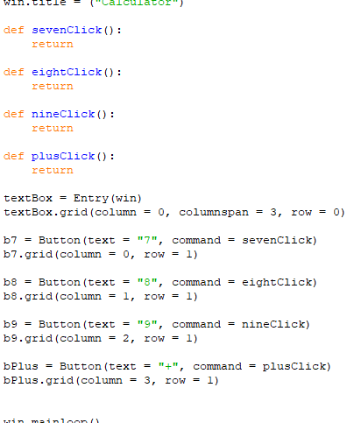

Tkinter – making a calculator
Making the interface
Now for the first row of buttons. This will have 7, 8 , 9 and +.
In the code from activity 2, a single function was used to handle all of the button clicks, but we’re doing it differently so we’ll need a function for each button. These can be left empty for now.

Slide 18
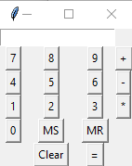

Tkinter – making a calculator
Making the interface
Duplicate the code for the buttons and the empty functions so that you have a full set of buttons and functions (don’t forget – we don’t need to do divide this time).
You should end up with something like the output on the right. We could make it a little neater by adding in the “pady” attribute to the button widget grid code like so:
But this is an optional extra, and you would need to add this to every one of your buttons.

Slide 19
Activity 3
Use the guidance on the previous slides to set up the user interface for the new calculator program.
The calculator won’t do anything at this stage, this part is just designing the interface.
Save your work as “lesson 7 activity 3”.

Slide 20

Tkinter – making a calculator
Inputting numbers
Now we have our interface, we need to add code to the button functions so our calculator does something!
Each time we press a number button, we want that number to appear in the text box. A single line of code is needed in each number adding function to input the relevant number. Here’s the code for inputting 7:
Add a similar line to each of the other number click functions.

Slide 21
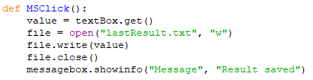
Tkinter – making a calculator
Saving
Next we will add in the saving and loading functionality. This will work in exactly the same way as the code from activity 2 earlier, but in my preferred style rather than the WJEC’s! This is all done with code you have used in previous tutorials.
First we have the saving code:

Slide 22
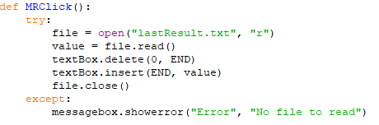
Tkinter – making a calculator
Loading
Now the loading code:

Slide 23

Tkinter – making a calculator
Variables
Before we add functionality to the operator buttons (+, - and *), we need some variables for keeping track of the first number the user enters, and the operation that they have selected to perform.
These two lines should go at the top of the widget definitions, underneath your functions.

Slide 24

Tkinter – making a calculator
Adding
Now we have the variables, we can add code to the plus button function.
Retrieves the value in the textbox, casting it to an integer because it will be read in as a string. The value is then given to the firstNumber variable.
Clear the text box so that the next number can be entered.
Set the value of the operation StringVar to “add” so we know what operation should be done when equals is pressed

Slide 25
Tkinter – making a calculator
Minus and multiply
Now add similar code to the minusClick and multiplyClick functions. There is only one change that needs to be made to the 3 lines of code for these functions.

Slide 26
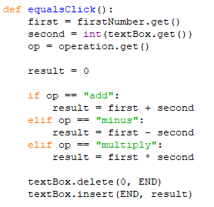
Tkinter – making a calculator
Equals
The biggest function will be the equalsClick.
These 3 lines retrieve the necessary data – the first number stored earlier, the second number just entered, and the desired operation.
Depending on the value of op, the necessary operation is performed, and the answer displayed to the user.

Slide 27

Tkinter – making a calculator
Clearing
Finally, add the following code to the clear button function:

Slide 28
Activity 4
Use the guidance on the previous slides to create a simple working calculator. Test it thoroughly to make sure that it can perform all of the operations described in the question on slide 11 correctly.
Add comments to your code to explain how it works.
Save your work as “lesson 7 activity 4”.
Extension ideas:
Add validation so that an error appears if the user tries to perform any operation when the textbox is empty.
Adjust the code so that it uses lambda function calls for each button click, and a single function handles all of the number button presses, one for the operation clicks and one for the MS/MR/Clear clicks
Extend the functionality of the calculator to include integer division, and perhaps other operations as well.
Add functionality for working with more than 2 numbers.
Any other improvements you’d like to make!
Save any extension work as “lesson 7 extension”

Slide 29
Uploading your work
You should now have 4 complete Python files from today’s lesson, plus any extension work. On Google classroom you will find an assignment for this lesson, and you need to upload your completed Python file to this assignment.
If you have any problems doing this, please speak to your teacher.

